Slide 1









Maintaining SmartX Multi-View Operations for OF@TEIN+ Distributed Cloud-native Edge Boxes
Muhammad Ahmad Rathore
Networked Intelligence Lab (now) Networked Computing Systems Laboratory (Prev)
School of Electrical Engineering and Computer Science (EECS)
Gwangju Institute of Science and Technology (GIST)
Gwangju, South Korea
IoTcloudServe@TEIN Collaboration Workshop 2

Slide 2
Related Research Papers
M Ahmad Rathore, M Usman, JW Kim. “Maintaining SmartX Multi-View Visibility for OF@TEIN+ Distributed Cloud-native Edge Boxes.” Transactions on Emerging Telecommunications Technologies (2019): Submitted.
Persistent Operation of OF@TEIN+ Playground Verified by SmartX Multi-View Leveraged Visualization, The 12th ICFCC 2020: To be submitted

Slide 3
Outline
OF@TEIN+ Playground: Overview
Cloud-Native Edge Boxes
Playground Production-focused Tower with Centers
SmartX MultiView Multiple Layers of Visibility
Maintaining Operations of OF@TEIN+ Playground
Step 0: Objectives and Requirements
Step 1: Design and Implementation for Persistent Playground Operations
Step 2: Maintaining Visualization for Persistent Playground Operations (Visibility) for Service Developers and Operators
[2-1] Resource Layer Visualization
[2-2] visualization for Visibility loss recovery
[2-3] Visualization for Flow Layer Volume
[2-4] Onion-ring based visualization
Notes:
This is the outline of my today’s presentation…

Slide 4
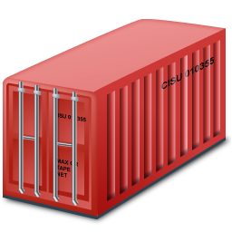
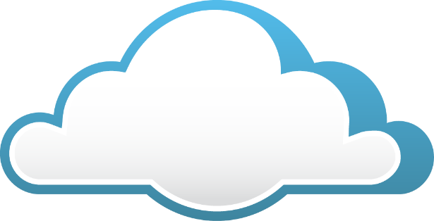
Cloud-Native Edge Boxes

Slide 5

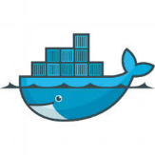


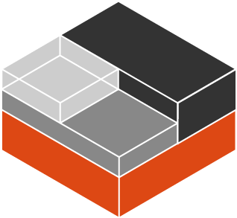

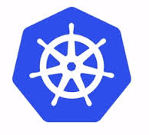
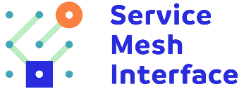
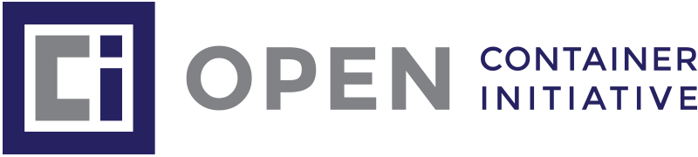


Cloud-native Computing
Cloud native computing uses an open source software stack to be:
Containerized
Dynamically orchestrated
Microservices oriented
microservices + automation + DevOps
➔➔
Agility of software teams +
Resilience of applications.
Notes:
Cloud-native is methodology of building and running application that fully exploits the power of cloud computing where application build on cloud have common characters.
First cloud-native apps adopt a Microservices architectures where each application is collection of small services that can be operated independently of each other.
Second Cloud-native apps are packed in containers which provide isolation context together with scalability and portability from one environment to another. Making them ideal for making application made of Microservices. Third cloud-native apps
Third Cloud-native application are often build and run on modern cloud-native platform such as Kubernetes helping in terms of Orchestration

Slide 6
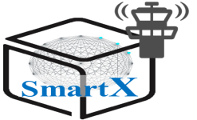
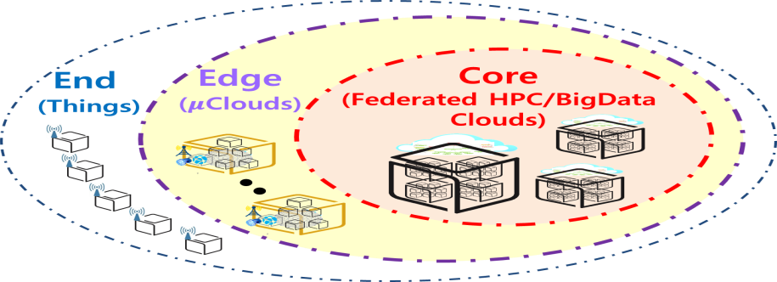
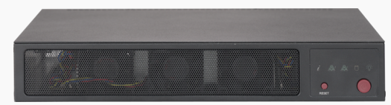
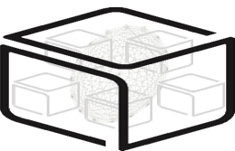


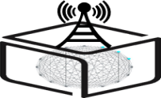
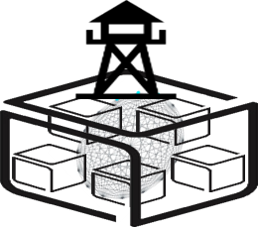
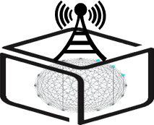
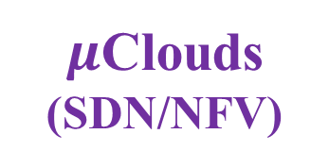
SmartX Composable Playground with Boxes
Type B/C
SmartX
Cloud Box
SmartX µBox
Type O
Type K/S
SmartX
DevOps Tower Cloud
with DataLake
SmartX
Edge μBoxes
SmartX
Edge Cluster
End
Edge
Core
Things
$μ$Clouds (SDN/NFV)
Clouds (HPC/BigData)
Notes:
Edge Computing places networked computing resources as close as possible to where data is created. In recent year, a large variety of applications, such as Internet of things (IoT) applications have appeared as cloud-based systems. This result in manifold increase of users or devices which get connected to internet and resulting in huge amount of data processing in cloud data center .
The burden caused by large data volume, generated by end-users and transferred at centralized cloud, lead to insufficient utilization of bandwidth and and conmputing resources. To tackle this problem, edge computing is aimed to increase capabilities and responsibilities of resources at the edge of network in comparison with traditional centralized cloud.
Edge computing leverages or allows? cloud-native devices to process/analyze some of their own visibility or user data. This can improve latency as well reduce the bandwidth constraints over the network and storage at the center. Thus in a cloud-native environment, edge computing moves applications workload from a centralized location to remote locations. Cloud-native supports edge by managing containerized applications at the edge providing microservices, isolation and orchestration

Slide 7
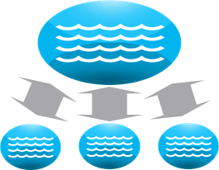
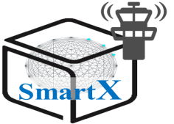

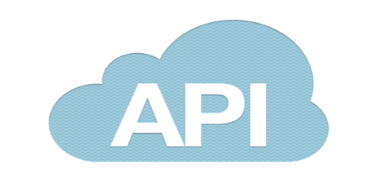


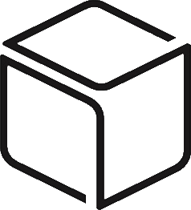

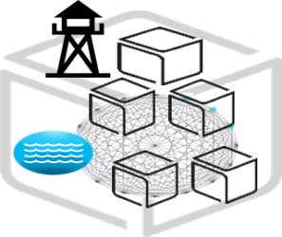
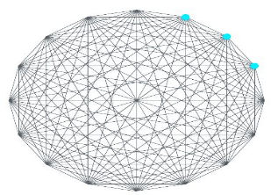
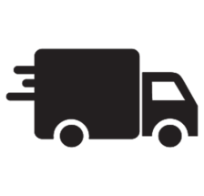




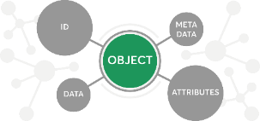
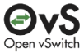
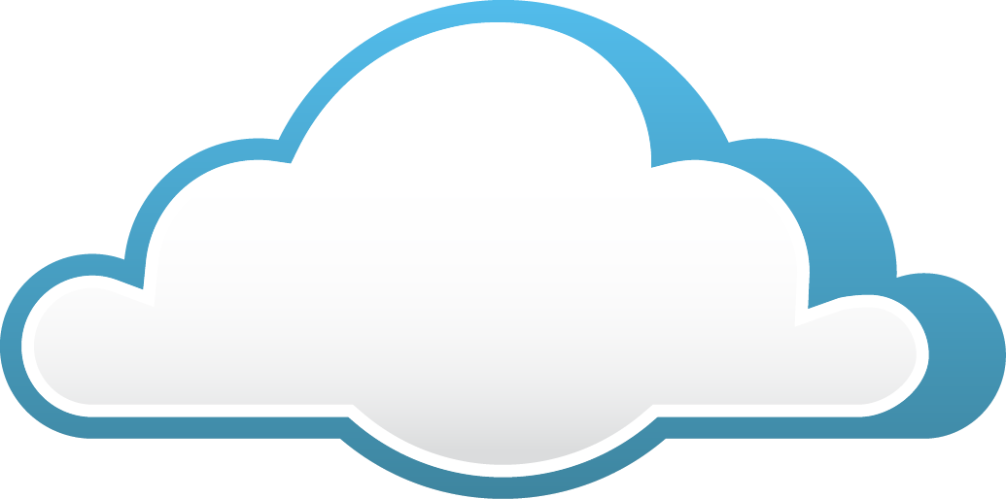

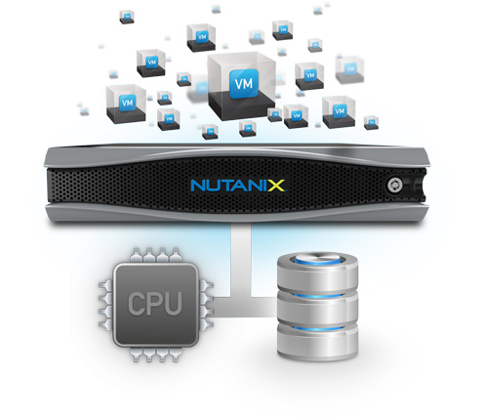


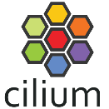
Connected DataLake & Edge Clusters + Core Cloud
Edge Cluster with DataPond
Data-Centric Transfer & Open Data Sharing
Open APIs & Library
Open MetaData Exchange with Licenses
Core Cloud with DataLake
eBPF
XDP

Slide 8

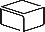
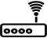

OF@TEIN+ Playground
2018.01.17
GIST
Tower Boxes
DataLake
Centers
SmartX μBox
P+O
V
S
ID
DataLake
Controllers
SmartX Box
Playground Tower
Production-focused
Sites with
SmartX μBox for IoT Devices
Sites with SmartX Box
NREN
Site Net.
Site Net.
NREN
NREN
TEIN
NREN
Underlay
Networks
NREN
UM
NCKU
SD-WAN
Edge Cloud
Controllers
SDX
Centers
Controllers
Centers
P
O
P
V
S
ID
SOC
ID
V
S
SDX
End (IoT/Access)
DataLake
DataLake
Playground Tower
Playground Tower
SandBox
Research-focused
Incubation-focused
Notes:
“OF@TEIN+: Open/Federated Playgrounds for Future Networks” was successfully continued till May 2019 in order to further enhance, extend and expand OF@TEIN collaboration.
At the end of OF@TEIN+, 14 SmartX MicroBoxes are installed and deployed at member sites to enable distributed cloud-native (Kubernetes-orchestrated) playground. Most importantly, this version of SmartX Playground is visibility-enabled (i.e., monitored) and jointly operated by federated playground towers deployed in four major sites

Slide 9
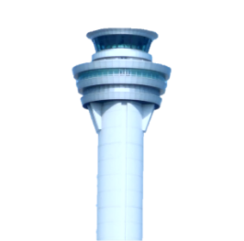






Converged OF@TEIN+ Playground (2019)
(Production-focused Playground Tower for SmartX Micro-Boxes Operation)
Converged SmartX
Playground Tower
with Platform Centers/Controllers
GIST (Gwangju)
SmartX Playground
Sites and Boxes
ID Center
+ OpenStack
Keystone
SmartX
SD-WAN
Controller
Sec
Center
SmartX
SD-Access
Controller
C$
O*
SD-
Access
UCSY-1
TOR
S
Cloud
IoT Things
V
Center
P + O
Center
O$
KOREN
SD-WAN
UCSM-1
O$
O$
GIST-1
TEIN
PTIT
O$
O$
GIST-2
14 SmartX MicroBoxes
Enable distributed cloud-native
(Kubernetes-orchestrated) playground
Visibility-enabled (i.e., monitored) and
Jointly operated by federated playground towers
O$
UM-1
VNU
O$
O$
O$
O$
UM-2
Playground Inter-Connect
Interfaces
P/Ma+C+D
P/Ma+C
Data
TEIN Trunk(P/Ma+C/D)
KOREN VLAN Trunk
ITC
O$
O$
MONASH
ITB
CHULA
International Sites
Notes:
OF@TEIN+ playground leverages ‘SmartX Playground Tower’, a logical space in centralized location meant for automatically
build, operate and utilize OF@TEIN+ playground. Following the concept of ‘monitor control’ tower, playground
tower leads the operation of multi-site playground by employing several entities such as Visibility Center.
Unlike cloud-based infrastructure where we use virtual machines and allocate fixed resources to the
users, in Cloud-native we switch to the containers to deploy applications over these edge cloud boxes.

Slide 10





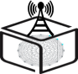


SmartX Multi-View: Multiple layers of Visibilities
Workload-layer Visibility
Monitor containerized applications
Inter-connected functions (e.g. Web, App, DB) and their placements
Flow-layer Visibility
Monitor overlay network traffic (near real-time)
Packet tracing
Packet sampling
Resource-layer Visibility
Monitor Playground resources
physical, virtual, and container
Monitor Infrastructure services
OpenStack Services, vSwitch service, SDN/Cloud Controllers services
Monitor Inter-connects
Physical
Management, Control, & Data planes
Virtual
vLinks, vPorts, vNetworks
Workload-layer
T
Pod
Pod
Containerized
Functions
App
App
Application
Developer
App
App
App
Flow-layer
Summarized
Identified
Collected
Application
Operator
Packets
Virtual Resource-layer
Virtual Networks
vSwitch
vLinks
vPorts
vSwitch
Playground Operator
Physical Resource-layer
Playground Operator
Baremetal
Sites
Site Operator
Underlay Resource-layer
Research Network(s)
Trans-Eurasia Information Network
Underlay Operator
Underlay Operator
A multi-layered visibility (underlay, physical, and virtual resource-layers, flow-layer, and workload-layer) solution denoted as SmartX multi-view visibility framework (MVF)
Notes:
In OF@TEIN+ Playground with Cloud-native edge boxes performance of resources/applications varies considerably depending on variations in running conditions e.g availability of virtual resources, network connection quality between distributed Boxes etc. Therefore tracking changes of operational environment is vital in order to maintain and sustain playground services. Therefore, the use of monitoring capabilities at each layer of cloud-native edge helps the playground operators/administrators to recognize where any resource(physical/virtual/network) bottlenecks. Multi-layer (i.e. resource-layer and flow-layer) visbility is essential for the effective operation of such modern ICT infrastructures to easily highlight the above mentioned issues.

Slide 11

Step 0: Objectives and Requirements

Slide 12
Objectives
Setup affordable, software-defined (i.e.,composable) playground having hyper-converged Cloud-native Edge Box-style resource
Maintain visibility support with SmartX MultiView Visibility Framework (MVF) consisting of four layers of playground visibility.
Implementing flow-centric visibility to integrate visibility data between layers and active monitoring edge boxes.
Notes:
Operational issues at OF@TEIN+ Playground
Hardware failures,
Resource availability failures,
Network failures, and
Flaws in software being triggered by environmental changes
Some of these failures can escalate and significantly affect SmartX MVF operations, thus causing critical limitations in Visibility.
To overcome these limitation we configured and deployed cloud-native edge boxes in the OF@TEIN+ playground ensuring consistency, reliability, and robustness.

Slide 13
Requirements of maintaining Visibility at OF@TEIN+ Playground
Multi-layer Monitoring Support with near real-time execution
Handle ever increase volume during tracing collection due to large number of scalable distributed devices at a limited Data Lake (centralized storage)
Reliable, consistent and resilient transfer of visibility data
Multi-layer Visualization support with long term persistent storage.

Slide 14
‘Persistence Operations’ for distributed Cloud-native edge Boxes
Persistent Multi-View Visibility
+
Managing Containerized Applications
Enable collection of visibility data from the Cloud-native Edge Boxes to a centralized location, ensuring consistency (longer period), reliability visibility data transfer), and robustness (Functionalities keep running).

Slide 15

Step 1:Design and Implementation for Persistent Playground Operations
[1-1] Design and Implementation of maintaining persistent visibility
[

Slide 16
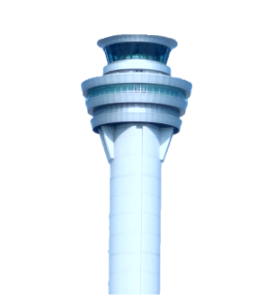


Design of maintaining persistent visibility at Micro-Box, Interconnection, and SmartX Visibility Center.
P
Ma
Me/C
D
SmartX Playground Tower
P + O Center
ID
Center
S Center + SDN Cont.
Box-Agent
Configuration
Center-Agent
Monitor/start
Communicate
Persistent Producer
Monitor/start
Communicate
Persistent Storage
Visualization
(Visibility + Onion-ring
Flows Summarization
Events Generation
Parsing
Reporting
Summarization
Aggregation
Measurement
+
Tracing
Measurements + Tracing Collector
Persistent Consumer
Parsing
Validation
SmartX Micro-Box
Shared message queue
SmartX Visibility Center
Visibility data
Storage and Staging (DataLake)
Visualization
NREN
NREN
NREN
Collection and Validation
Integration
(Analytics)
Site A
Site B
Site C
SmartX MVF Architecture

Slide 17







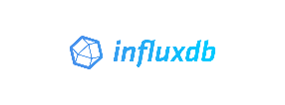

Implementation of maintaining persistent visibility at Micro-Box, Interconnection, and SmartX Visibility Center.
P
Ma
Me/C
D
SmartX Playground Tower
P + O Center
ID
Center
S Center + SDN Cont.
Box-Agent
Configuration
Center-Agent
Python
ZeroMQ
Temporary
Storage
Kafka Producer
Python
ZeroMQ
MongoDB/
ElasticSearch
Kibana/NodeJS
Spark+Scala
(flows summarization)
Python+Shell
(Formatting)
JSON
(Parsing)
shell/html
(Reporting)
Java
(Summarization)
Python/Shell
(Aggregation)
Measurement
+
Tracing
Measurements + Tracing Collector
Kafka Consumer
JSON (parsing)
Python/Shell
(Validation)
perfSONAR | Kubernetes | IO Visor | Collectd | FTP | ZeroMQ | Kafka | Python | Spark | Java
MongoDB | InfluxDB | Spark | NodeJs | git | ZeroMQ | ElasticSearch | Zookeeper/Kafka | Python | wget
SmartX Micro-Box
Shared message queue
SmartX Visibility Center
Visibility data
Storage and Staging (DataLake)
Visualization
NREN
NREN
NREN
Collection and Validation
Integration
(Analytics)
Site A
Site B
Site C
SmartX MVF Architecture

Slide 18
Selected list of multilayer visibility metrics for OF@TEIN+ Playground
Layer | Metric type | Key metrics | Measurement interval
Workload | Functionality Execution | Status | 30 seconds
Flow | Network controller functionality | Packets/port, data bytes/port | 30 seconds
 | Network controller availability | Access status, installed flow rules | 30 seconds
 | Packets sampling/tracing | No. of packets, data rates, data bytes | Event-based
Physical | Utilization | CPU/memory/disk/NIC utilization | 10 seconds
Resource | Availability | Power status, interface access status | 10 minutes
Underlay | Delay | One way delay, RTT | 10 minutes
Resource | Bandwidth utilization | TCP/UDP (bits/seconds) | 1 times/day

Slide 19
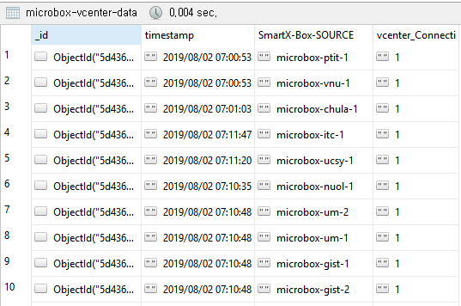
Multi-Agents Process flow and DB Collection
Start
V-Center Agent
Box Agent(s)
Check Running Status
Box Agent(s)
Check
Check
functionalities running
Yes
Check functionalities running
Not Running
Yes
Yes
Restart Box-Agent
Not Running
No
Measure down-time
Store Functionalities/Agent Status in DB
Send
Measure down-time
Send
Restart
Basic-Functionalities
Restart

Slide 20
Step 2: Maintaining Visualization for Persistent Playground Operations (Visibility) for Service Developers and Operators
[2-1] Resource Layer Visualization
[2-2] visualization for Visibility loss recovery
[2-3] Visualization for Flow Layer Volume
[2-4] Onion-ring based visualization
[

Slide 21
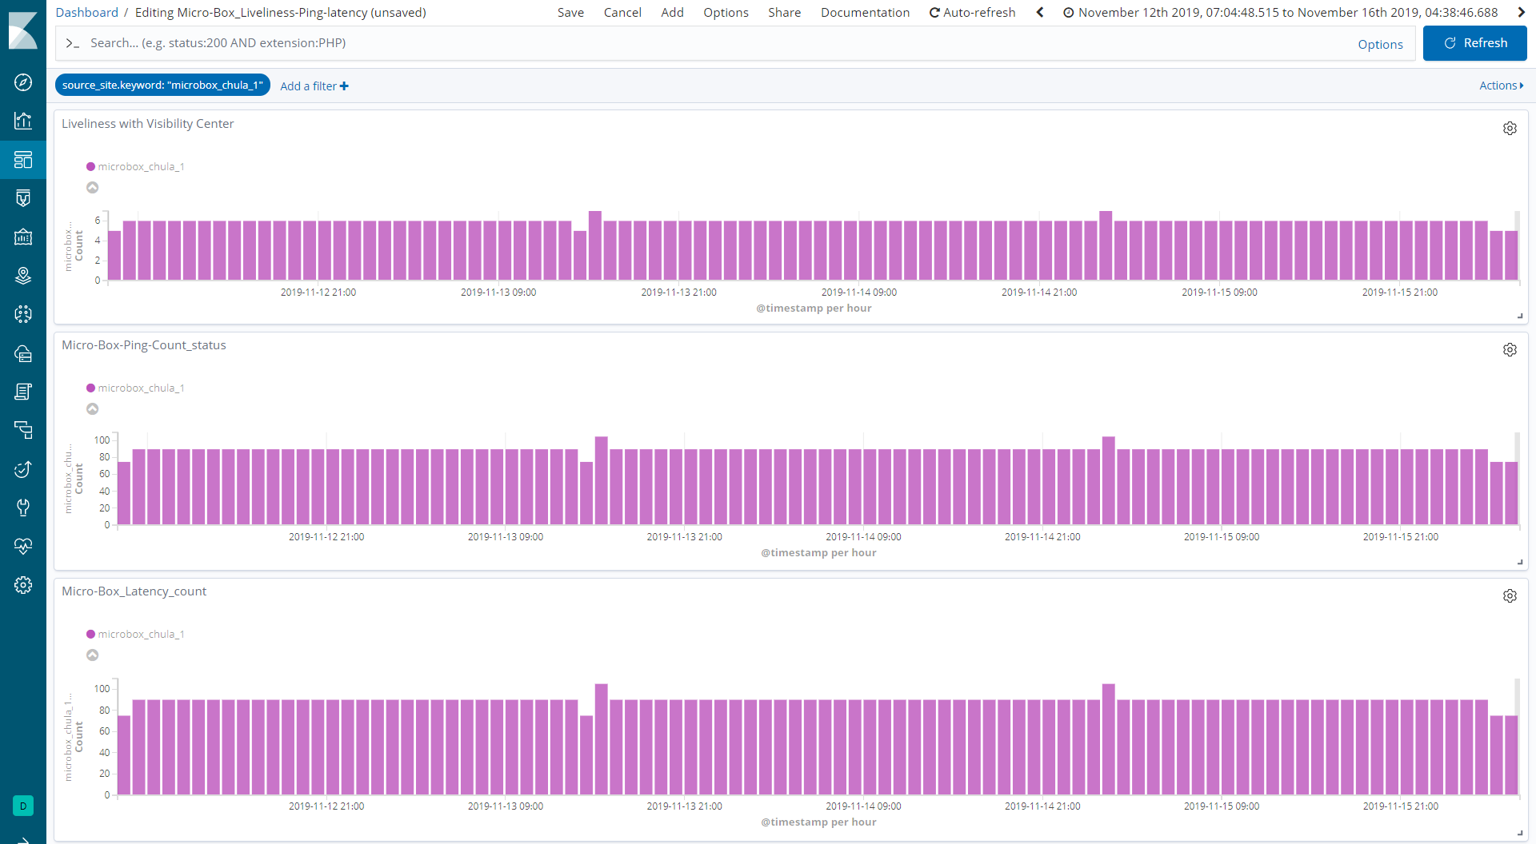
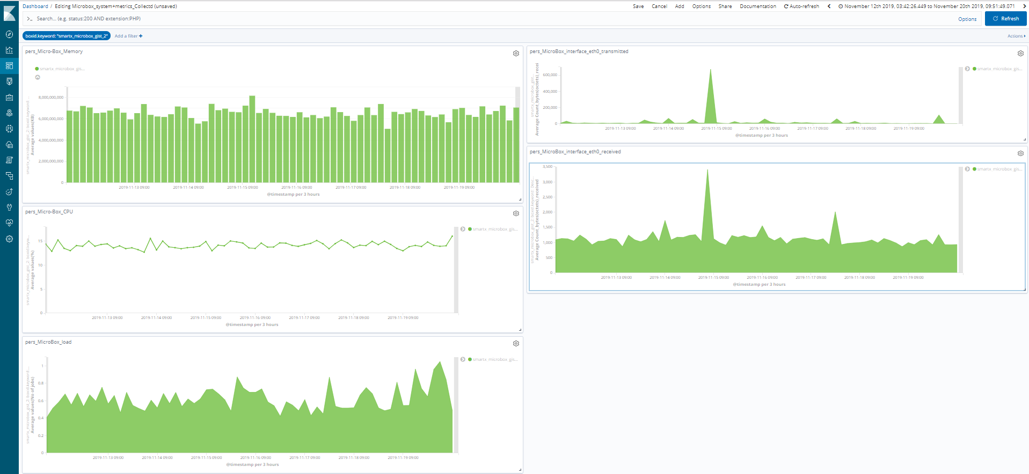
Resource Layer Measurement ( Active Monitoring + Passive Monitoring)
Liveliness
(Connection between Micro-Box to Visibility Center)
Memory
Network packets transferred
(bytes)
Network packets Received
(bytes)
Ping
CPU
Latency
Load

Slide 22
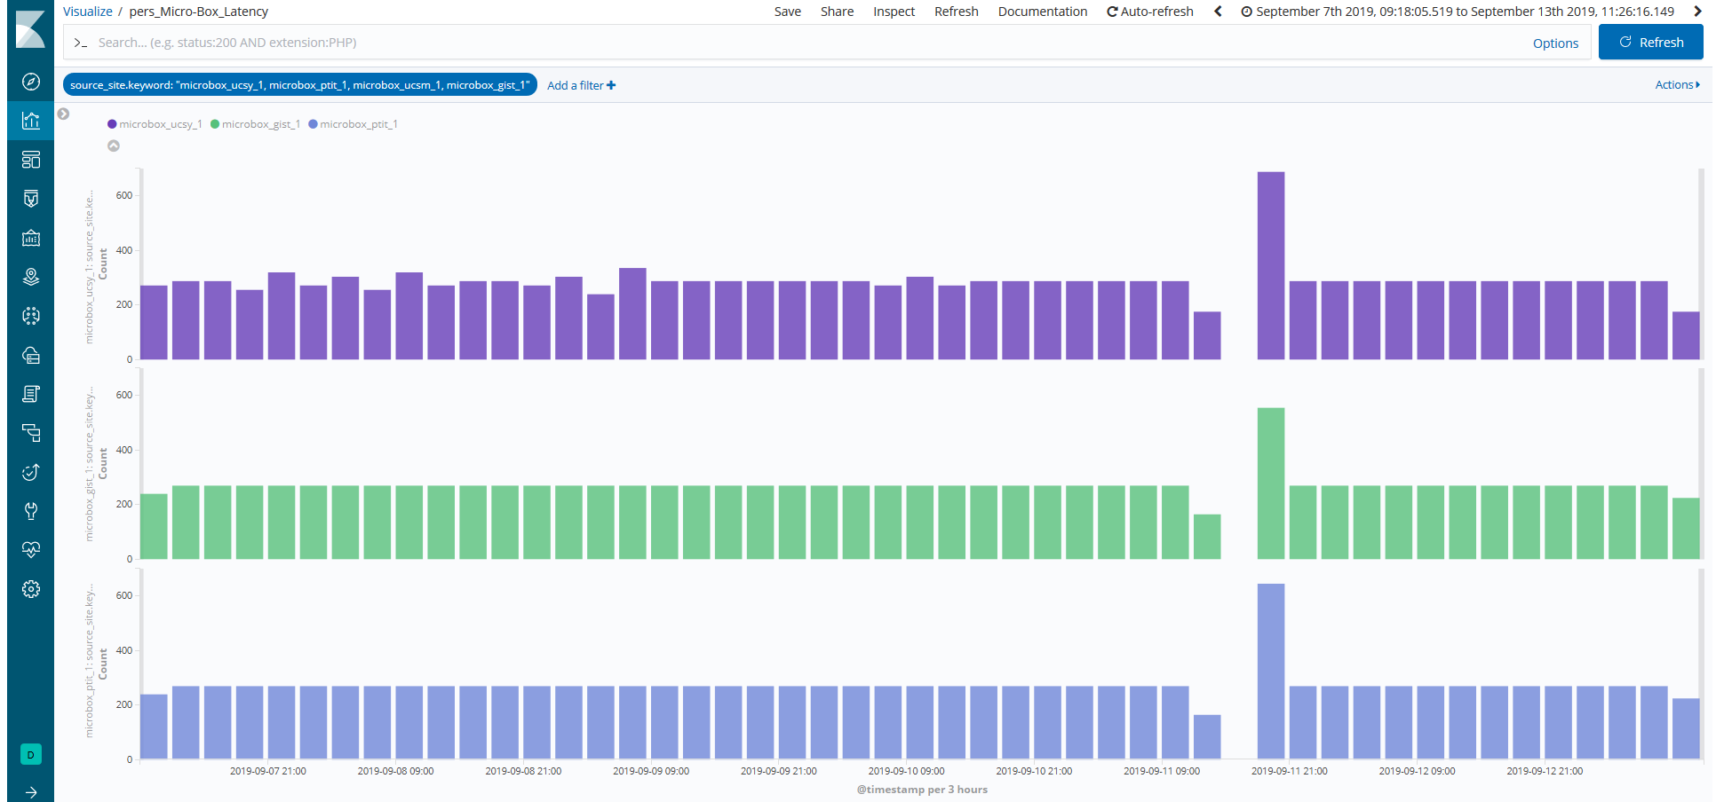
Visibility Loss Recovery
Visibility Loss
Visibility recovered

Slide 23
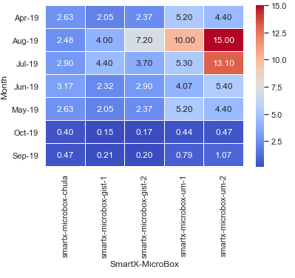
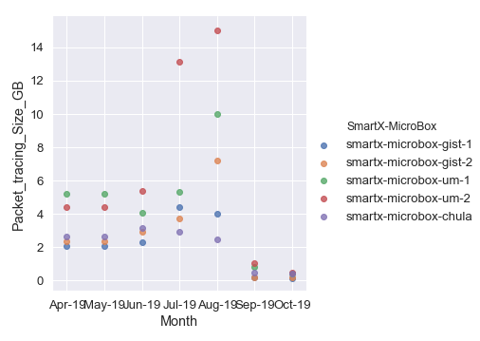
Visualization for volume generated during packet tracing and flows generation

Slide 24
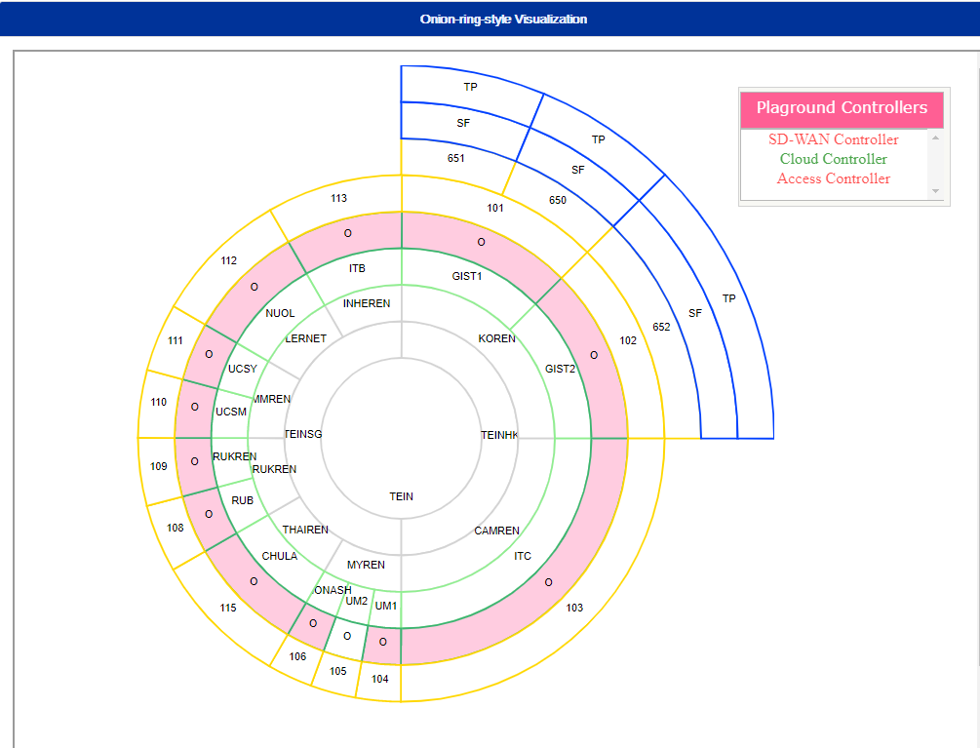
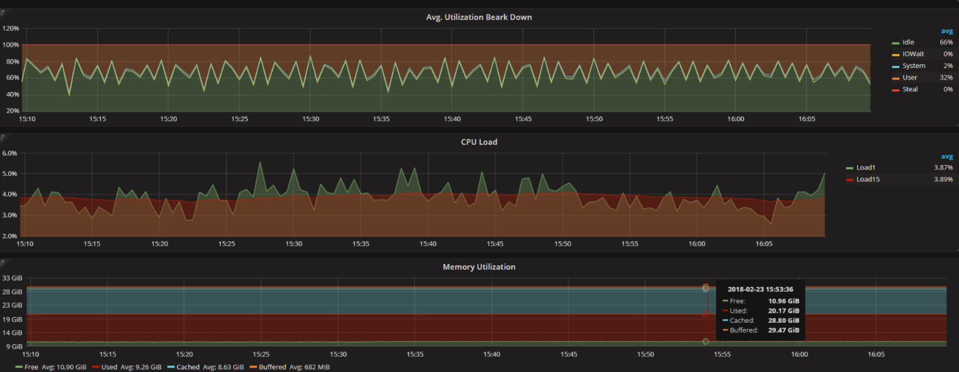
Onion-Ring Visualization for OF@TEIN+ Playground
Tracing Packet
Sampled Flows
TEIN
REN
Micro-Boxes
Box Type
IoT Hosts

Slide 25
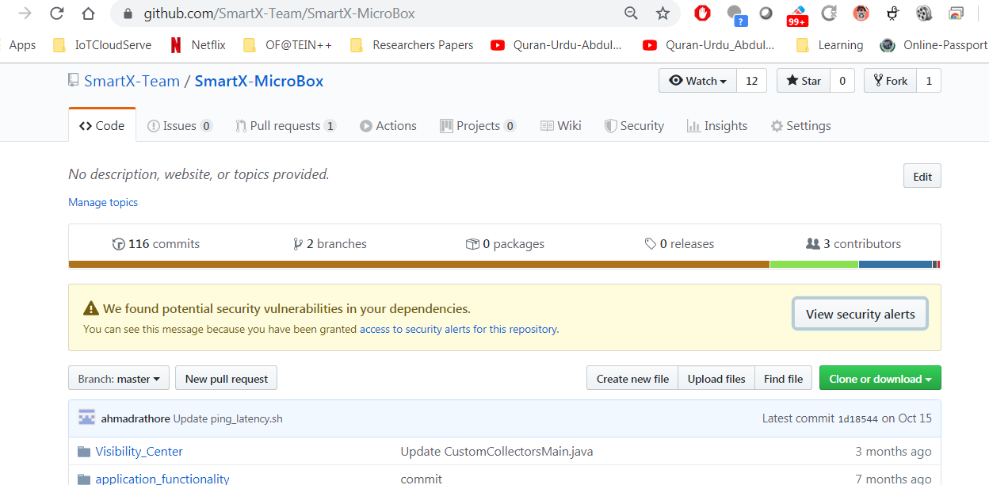
GitHub Repository
A prototype of proposed solution can be found on GitHub
https://github.com/SmartX-Team/SmartX-MicroBox.git)

Slide 26
Thank you

Slide 27
Helping Slides (not Part of Presentation)
Persistence Visibility’ for distributed Cloud-native edge boxes

Slide 28
Cloud-native is methodology of building and running application that fully exploits the power of cloud computing where application build on cloud have common characters.
First cloud-native apps adopt a Microservices architectures where each application is collection of small services that can be operated independently of each other.
Second Cloud-native apps are packed in containers which provide isolation context together with scalability and portability from one environment to another. Making them ideal for making application made of Microservices. Third cloud-native apps
Third Cloud-native application are often build and run on modern cloud-native platform such as Kubernetes helping in terms of Orchestration

Slide 29
Cloud-native Edge Boxes
Cloud-native: Cloud-native is more about how software is built and deployed than where’s it’s actually run.
Edge Computing places networked computing resources as close as possible to where data is created.
Connecting IoT devices to the Internet is not new but deploying and running real-time edge apps at hyperscale using these devices is.
Edge Computing leveraged the benefits of cloud-native by keeping what’s great about the Cloud-native model (Microservices architectures ,Containerized applications, Dynamically orchestrated), yet applying it in the harsh physical and environment of sensors and IoT devices.
Notes:
Edge Computing places networked computing resources as close as possible to where data is created. In recent year, a large variety of applications, such as Internet of things (IoT) applications have appeared as cloud-based systems. This result in manifold increase of users or devices which get connected to internet and resulting in huge amount of data processing in cloud data center [MNonitoring self-adaptive application within edge computing frameworks Salman Taherzadeh].. However, the burden caused by large data volume, generated by end-users and transferred at centralized cloud, lead to insufficient utilization of bandwidth and and conmputing resources. To tackle this problem, edge computing is aimed to increase capabilities and responsibilities of resources at the edge of network in comparison with traditional centralized cloud.
Connecting IoT devices to the Internet is not new but deploying and running real-time edge apps at hyperscale using these devices is. Edge Computing leveraged the benefits of cloud-native by keeping what’s great about the Cloud-native model (Microservices architectures ,Containerized applications, Dynamically orchestrated), yet applying it in the harsh physical and environment of sensors and IoT devices.

Slide 30
Multi-View Visibility concept and application in Cloud-Native Edge
Monitor and visualize the dynamic status metrics for both physical and virtualized resources and associated flows of the playground by leveraging SmartX MVF for OF@TEIN+ playground
Operational issues at OF@TEIN+ Playground
Hardware failures,
Resource availability failures,
Network failures, and
Flaws in software being triggered by environmental changes
Some of these failures can escalate and significantly affect SmartX MVF operations, thus causing critical limitations in Visibility.
To overcome these limitation we configured and deployed cloud-native edge boxes in the OF@TEIN+ playground ensuring consistency, reliability, and robustness.

Slide 31
Handling Storage in OF@TEIN+ Playground
OF@TEIN+ playground supports distributed devices in a heterogeneous environment,
Transmitting an increasing volume of data for at remote, centralized processing is become problematic.
Not least the in heterogeneous environment transmitting visibility data at frequent regular interval and serving user’s request can overload available network capacity and result in slow speed of response.
Edge computing leverages or allows? cloud-native devices to process/analyze some of their own visibility or user data. This can improve latency as well reduce the bandwidth constraints over the network and storage at the center.
This in a cloud-native environment, edge computing moves applications workload from a centralized location to remote locations.
Cloud-native supports edge by managing containerized applications at the edge providing

Slide 32
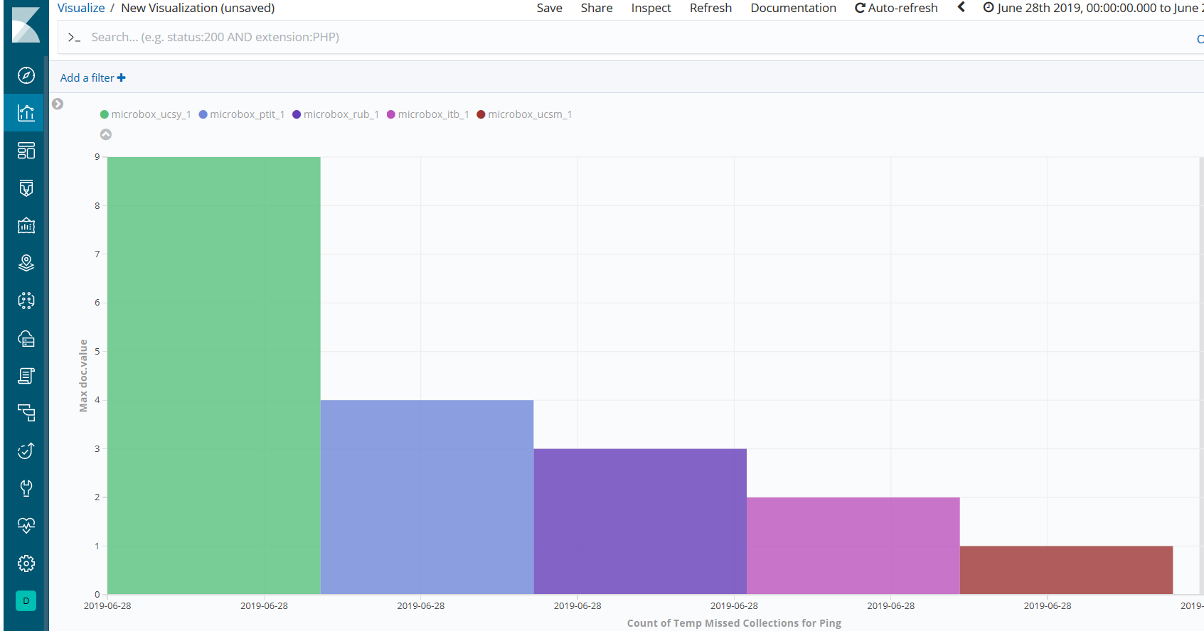

Slide 33
Definitions: Resource-layer, Flow-layer & Workload-layer Visibility
Resource-layer Visibility
Monitor Playground resources
physical, virtual, and container
Monitor Infrastructure services
OpenStack Services, vSwitch service, SDN/Cloud Controllers services
Monitor Inter-connects
Physical
Management, Control, & Data planes
Virtual
vLinks, vPorts, vNetworks
Flow-layer Visibility
Monitor overlay network traffic (near real-time)
Packet tracing
Packet sampling
Workload-layer Visibility
Monitor tenant-based applications
Inter-connected functions (e.g. Web, App, DB) and their placements

